Slide 1
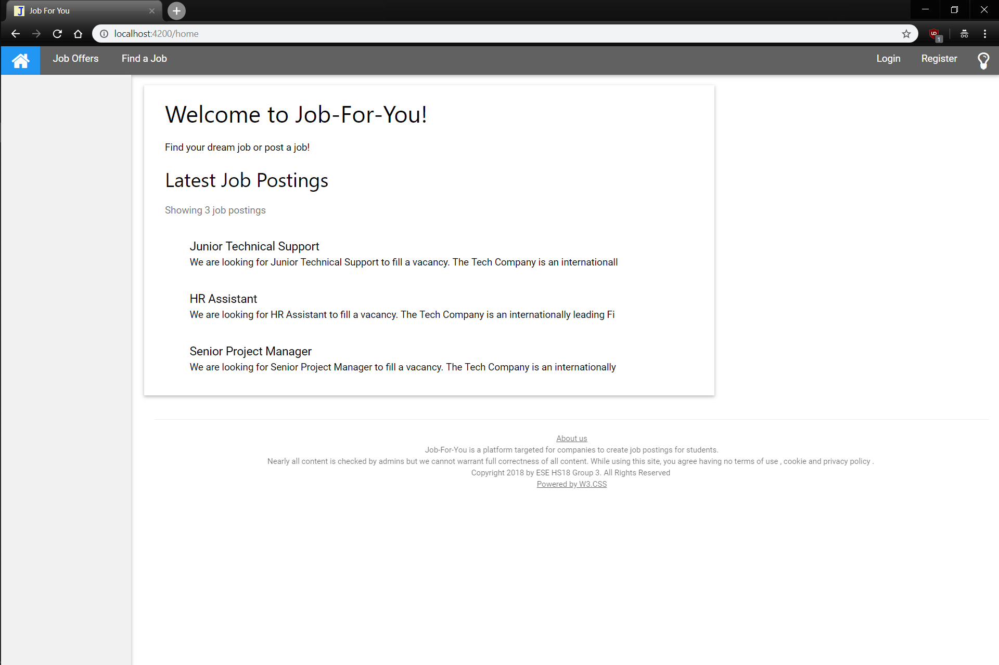
Redundant links / messages will not be displayed on subsequent pages
Redirect to ‘Home’, Job Offers or Find a Job (Search)
Login / Register lead to respective components. Lightbulb (on click) changes to night theme
Clicking on a job leads to details for that job
Redirect to About Us Page

Slide 2
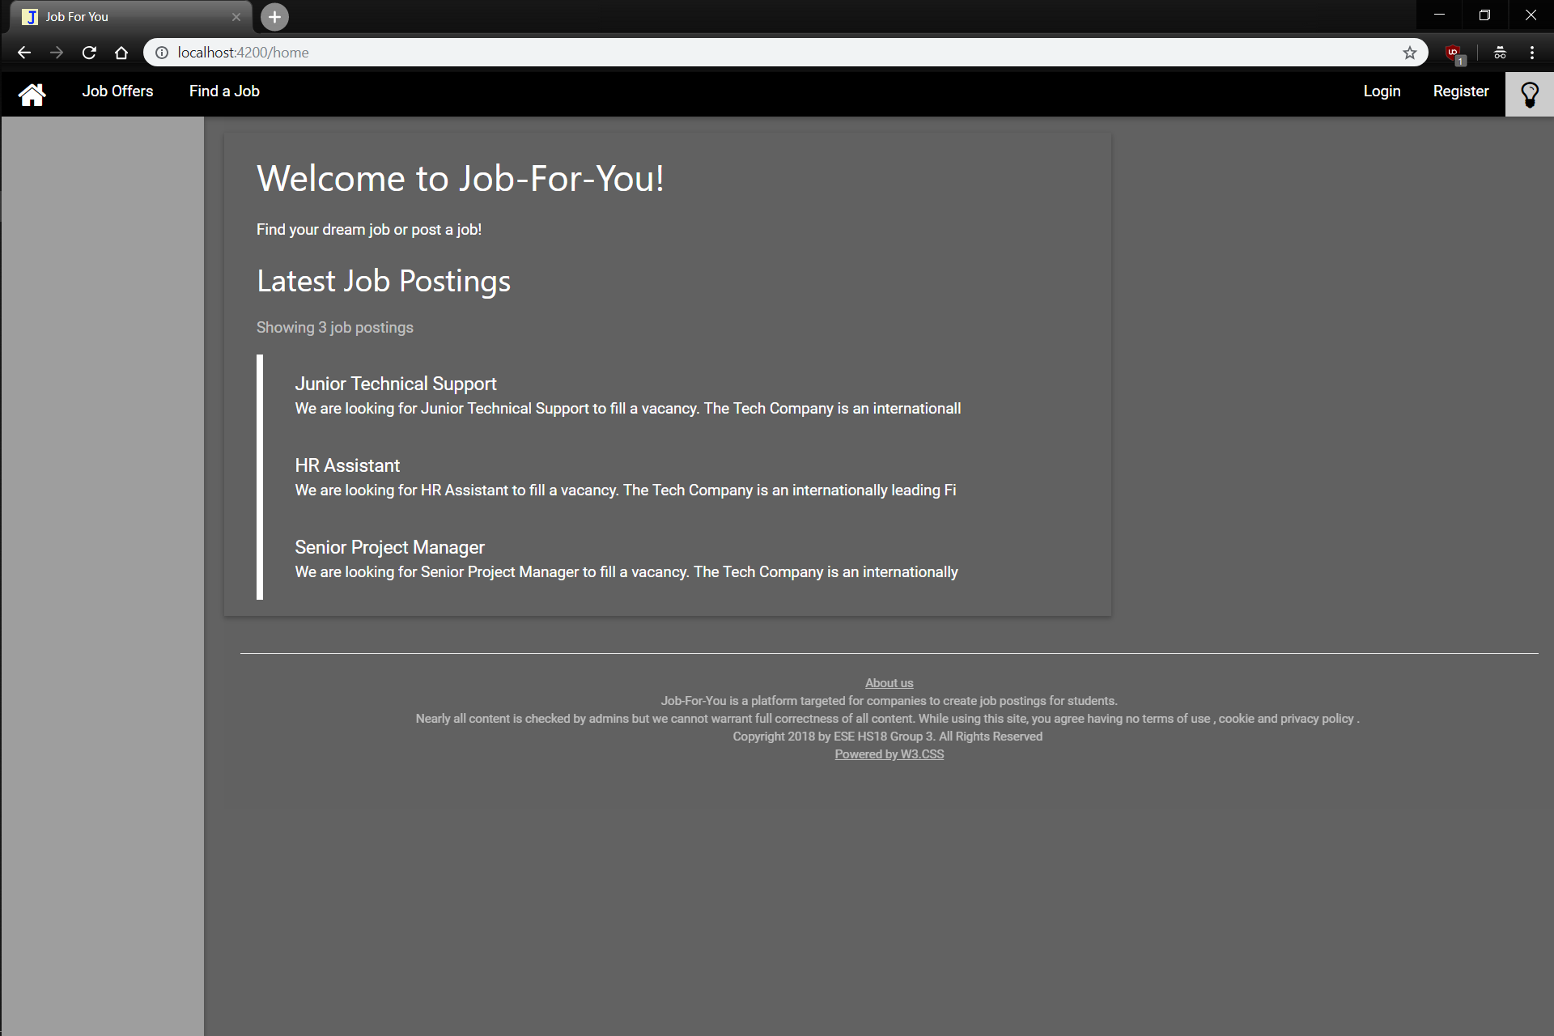

Slide 3
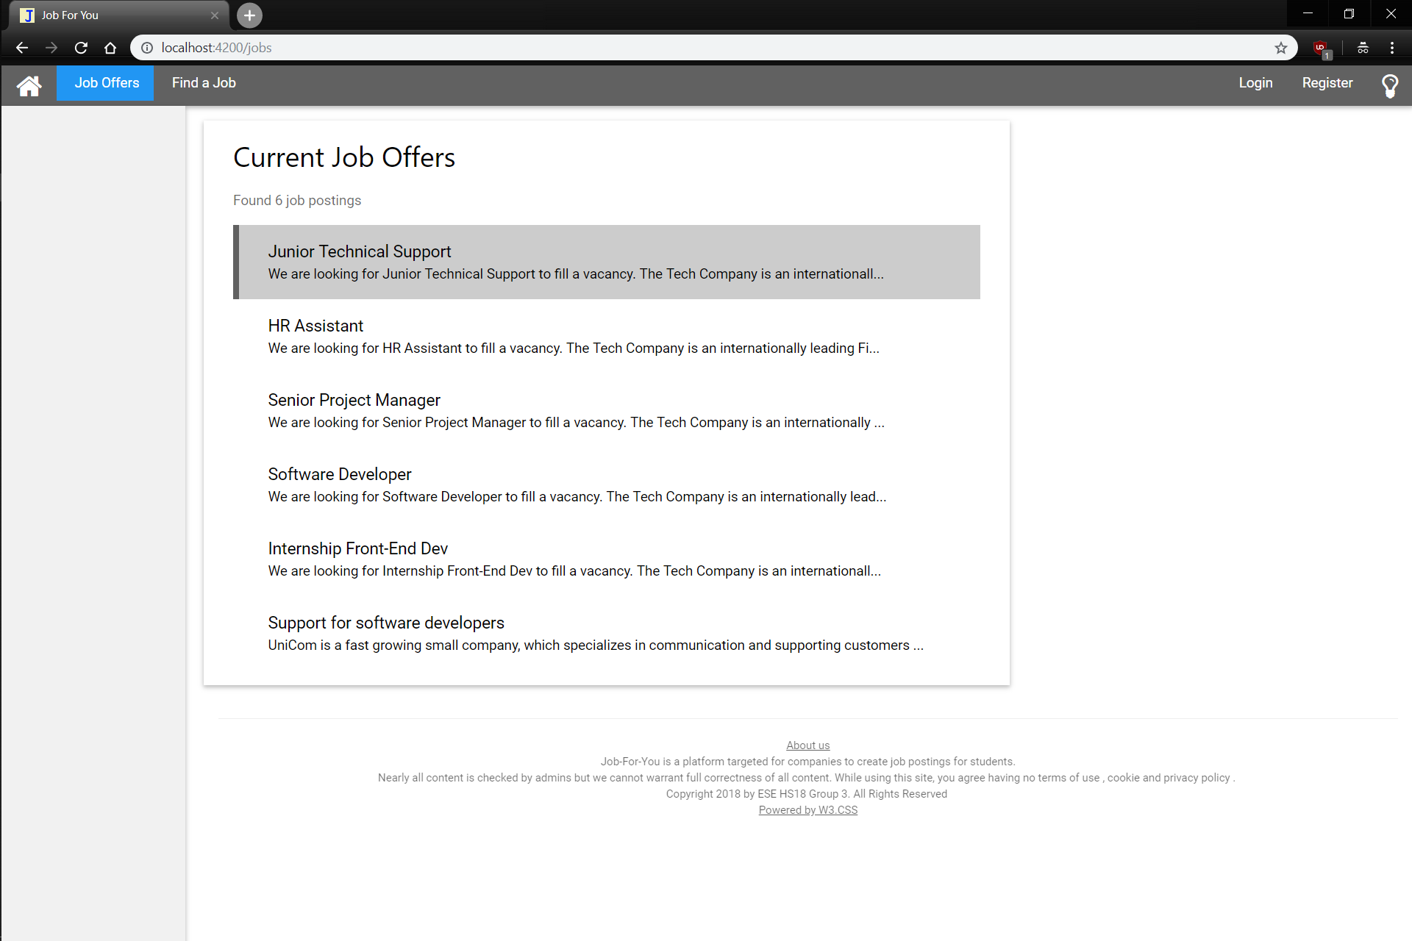

Clicking on a job leads to details for that job, the job where the mouse hovers has a highlight

Slide 4
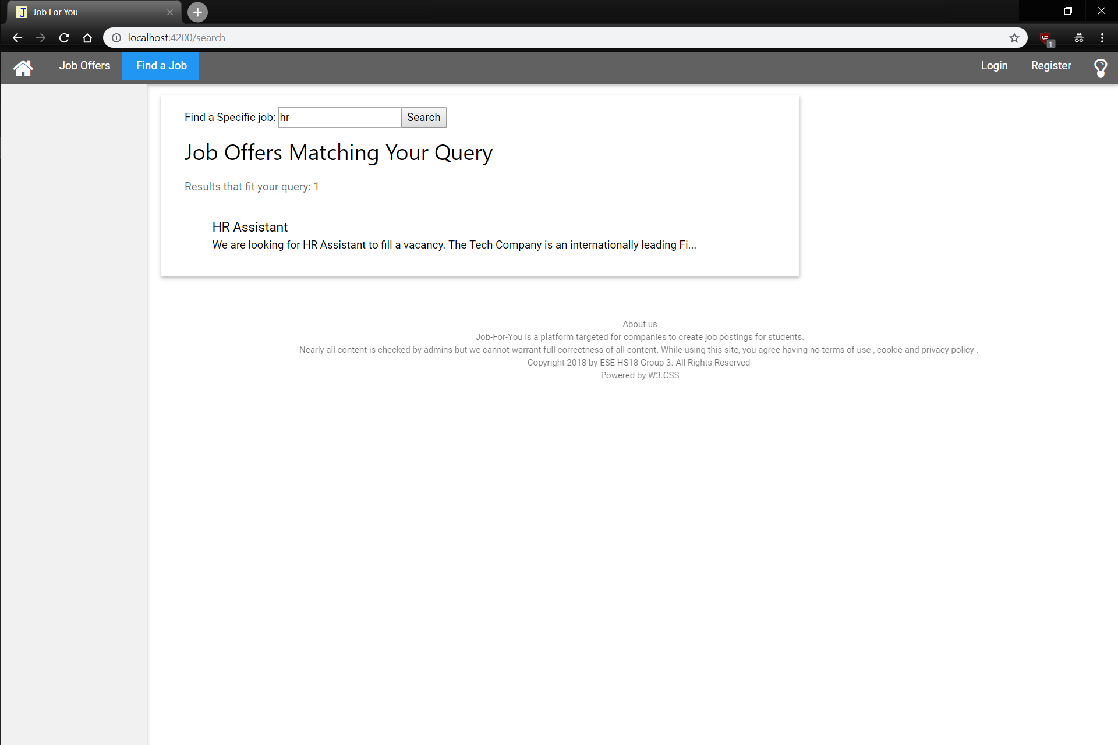
Entering a search term and pressing ‘Enter’ or the Search button searches job titles for matches

Slide 5
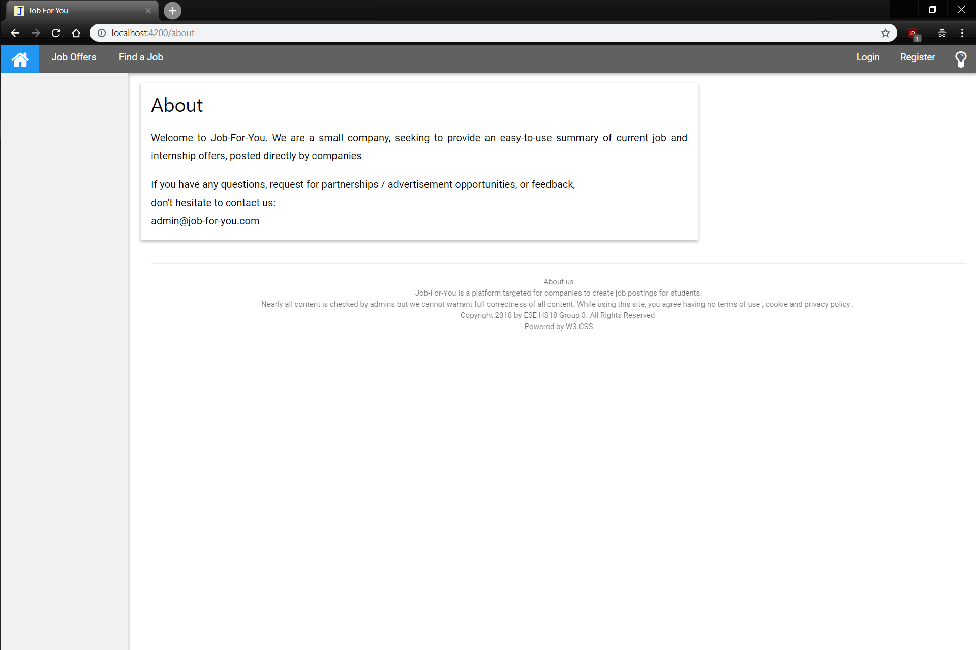
Entering a search term and pressing ‘Enter’ or the Search button searches job titles for matches
No additional comments needed

Slide 6
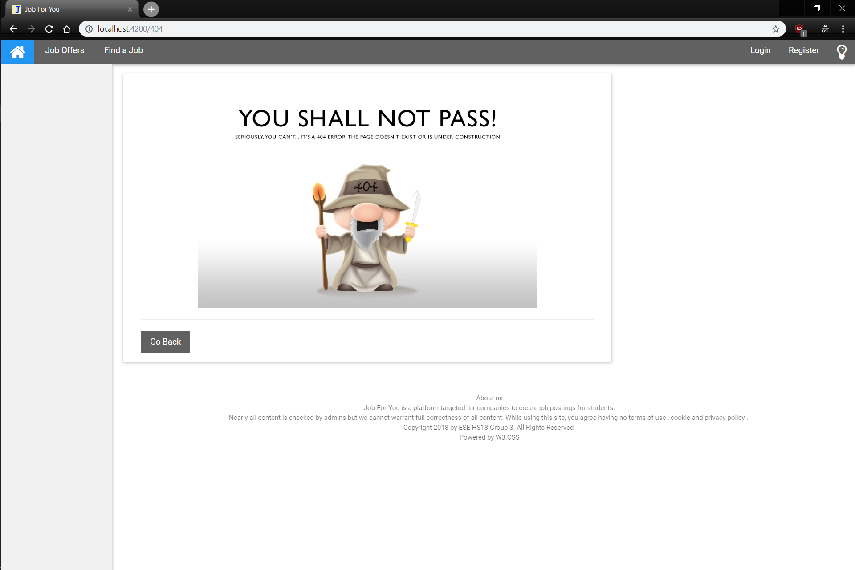
Entering / clicking any invalid URL redirects here
Redirects to the last visited page

Slide 7
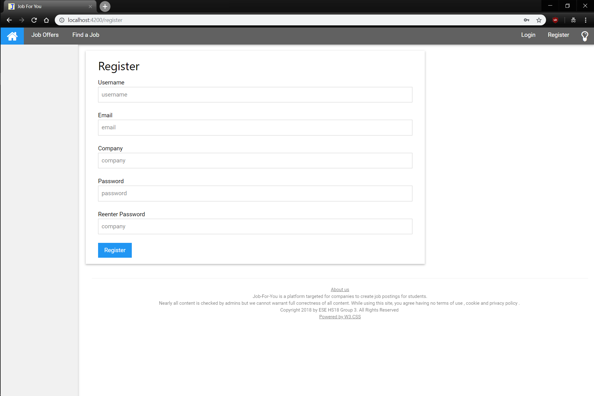
Submit the Form, Password must have a minimum length of 6 (error message otherwise)

Slide 8
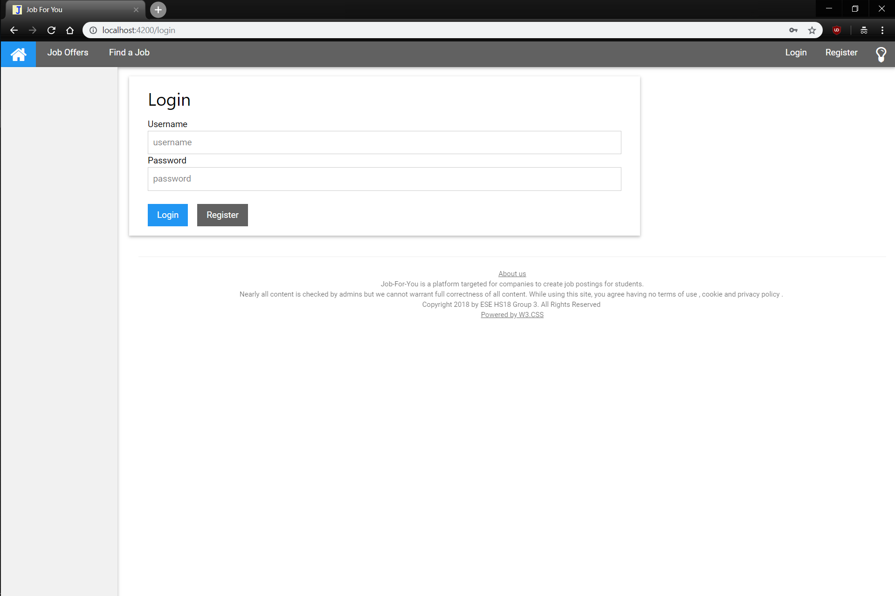
Login with your credentials or go to Registration Form

Slide 9
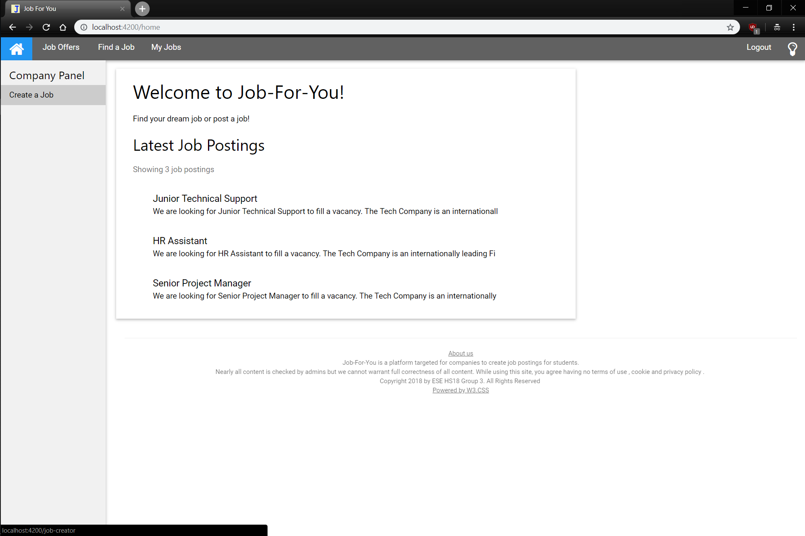
Shows all jobs that user has created
If logged in as a company (and not the admin) you get the following side-panel and the new navigation-bar entry
Redirects to Create a Job Form

Slide 10
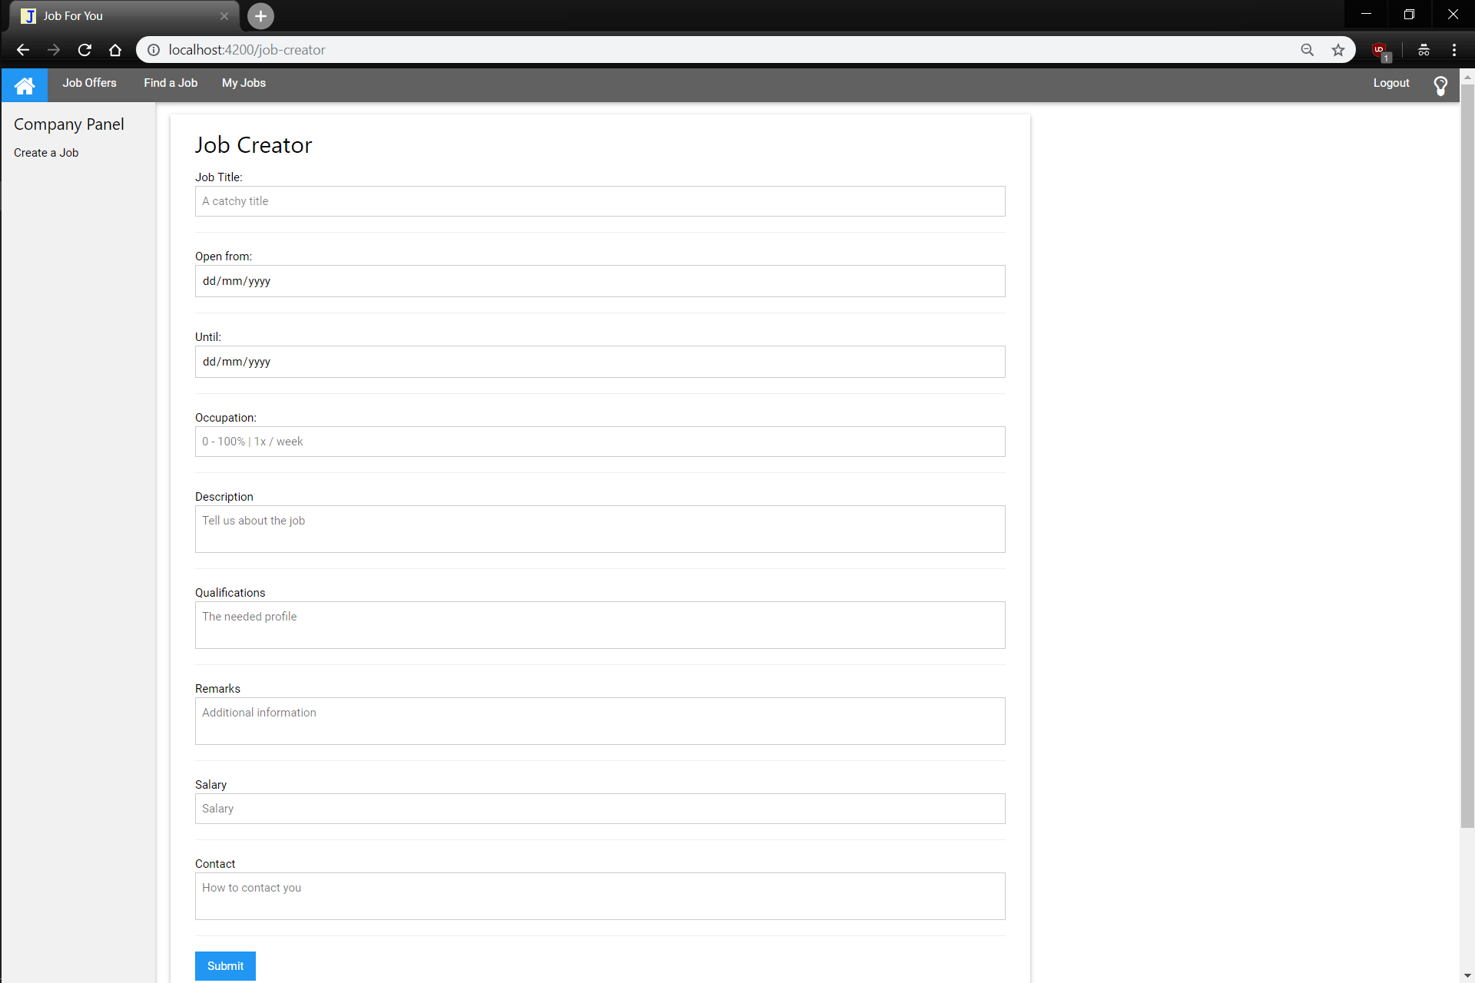
The form should be self-explantory, error if information not filled in

Slide 11
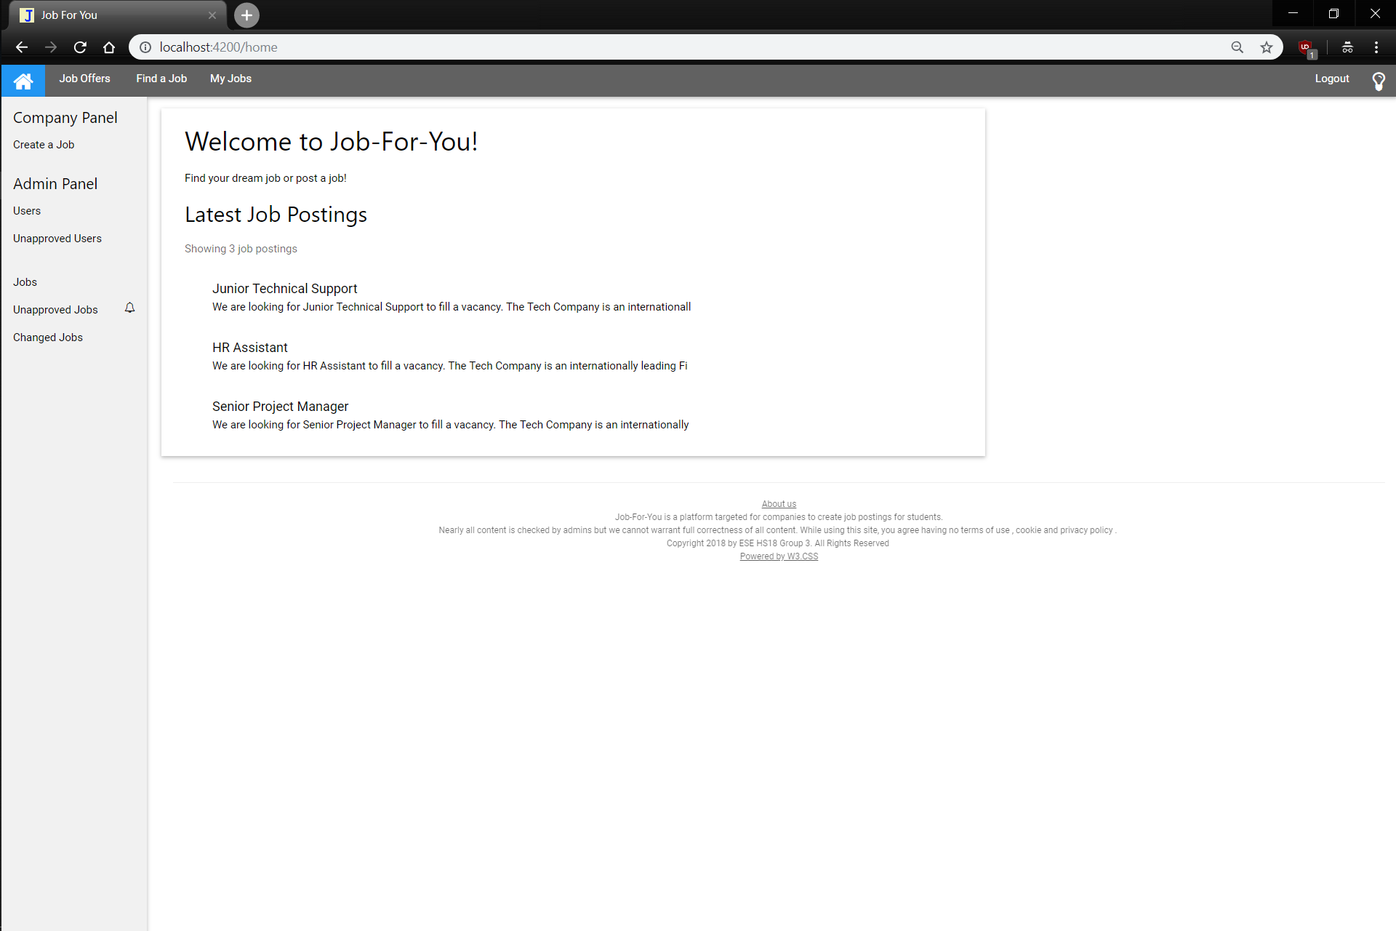
If logged in as admin you get an addition to the side-panel
The bells notify you of open tasks

Slide 12
Shows the User and their Company

